Slide 1

Title: Password Strength Checker & Cybersecurity Awareness Quiz
Subtitle: A Web-Based Security Educational Tool
CSCI 6991 Data Engineering Capstone
Group 3
Bidhan Arzel (Y00883659)
Dikkim Rai (Y00887134)

Slide 2


Introduction: Empowering Digital Security
Cyber threats increasing
Weak passwords → 80% of breaches
Users struggle to judge password strength
Our tool provides real-time guidance + quiz learning

Slide 3

Background
Attackers use brute-force, dictionary, leaked databases
Users reuse weak passwords
Low understanding of entropy & strength
Security training is often boring
Need interactive tools

Slide 4
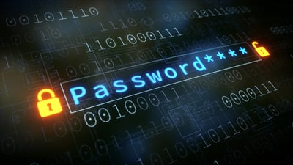
Problem statement
Users create weak, predictable passwords
Reuse of breached passwords
Low awareness of phishing & scams
Need better password education + awareness training

Slide 5

Methodology
Password Checker
Real-time score (0-4)
Entropy calculation
Common-password blacklist
Character analysis
Weak/strong/passphrase generator
Breach check (HavelBeenPwned)
Dashboard summary

Slide 6

Methodology
Quiz
65-question bank
Random 5 each session
Randomized options
Instant feedback
LocalStorage stats
Confetti, sounds, badges

Slide 7
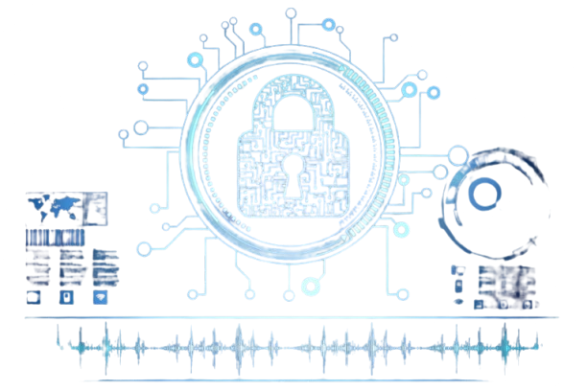
System Architecture
HTML, CSS, Javascript
Zxcvbn.js for scoring
Canvas-confetti
AudioContext
HavelBeenPwned API
LocalStorage for quiz stats

Slide 8

Experiments & Testing
Tested weak, strong, breached, passphrase passwords
Zxcvbn + entropy matched expected results
20 users tested quiz
Scores improved (48% → 78%)
Gamification improved engagement

Slide 9
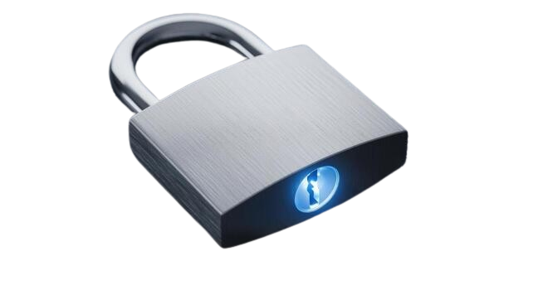
Results
Users improved password creation
Real-time tips helped learning
Quiz reinforced cybersecurity concepts
Celebration features increased motivation
Pre-test vs Post-test improvement

Slide 10
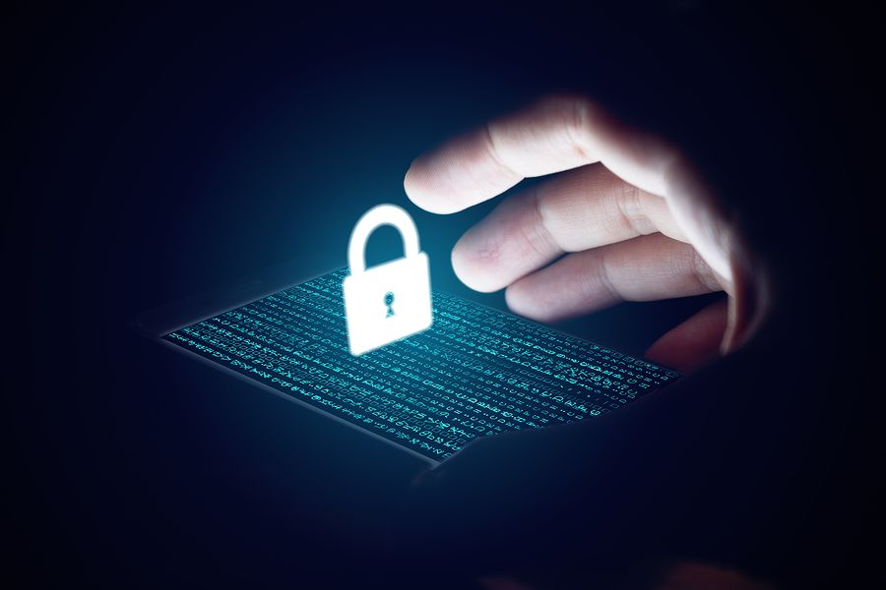
Discussion
Strengths
Interactive & Educational
Api-based breach check
Real-time feedback
Gamified & engaging
Limitations
Requires internet for HIBP API
Audio activation depends on user interaction
Future Work
ML-powered password insights
Multi-language support
Mobile app version
More training modules

Slide 11

Conclusion
Helps users build stronger passwords
Improves cybersecurity awareness
Fun, simple, and effective learning tool
Shows how UI/UX improves security behavior

Slide 12

Team Contributions
Bidhan Arzel
Password scoring logic
Entropy + breach API
Quiz logic & stats
Celebration sound + debugging
Dikkim Rai
UI/UX design
Theme System
Layout + animations
Confetti + visual polish

Slide 13


Slide 14
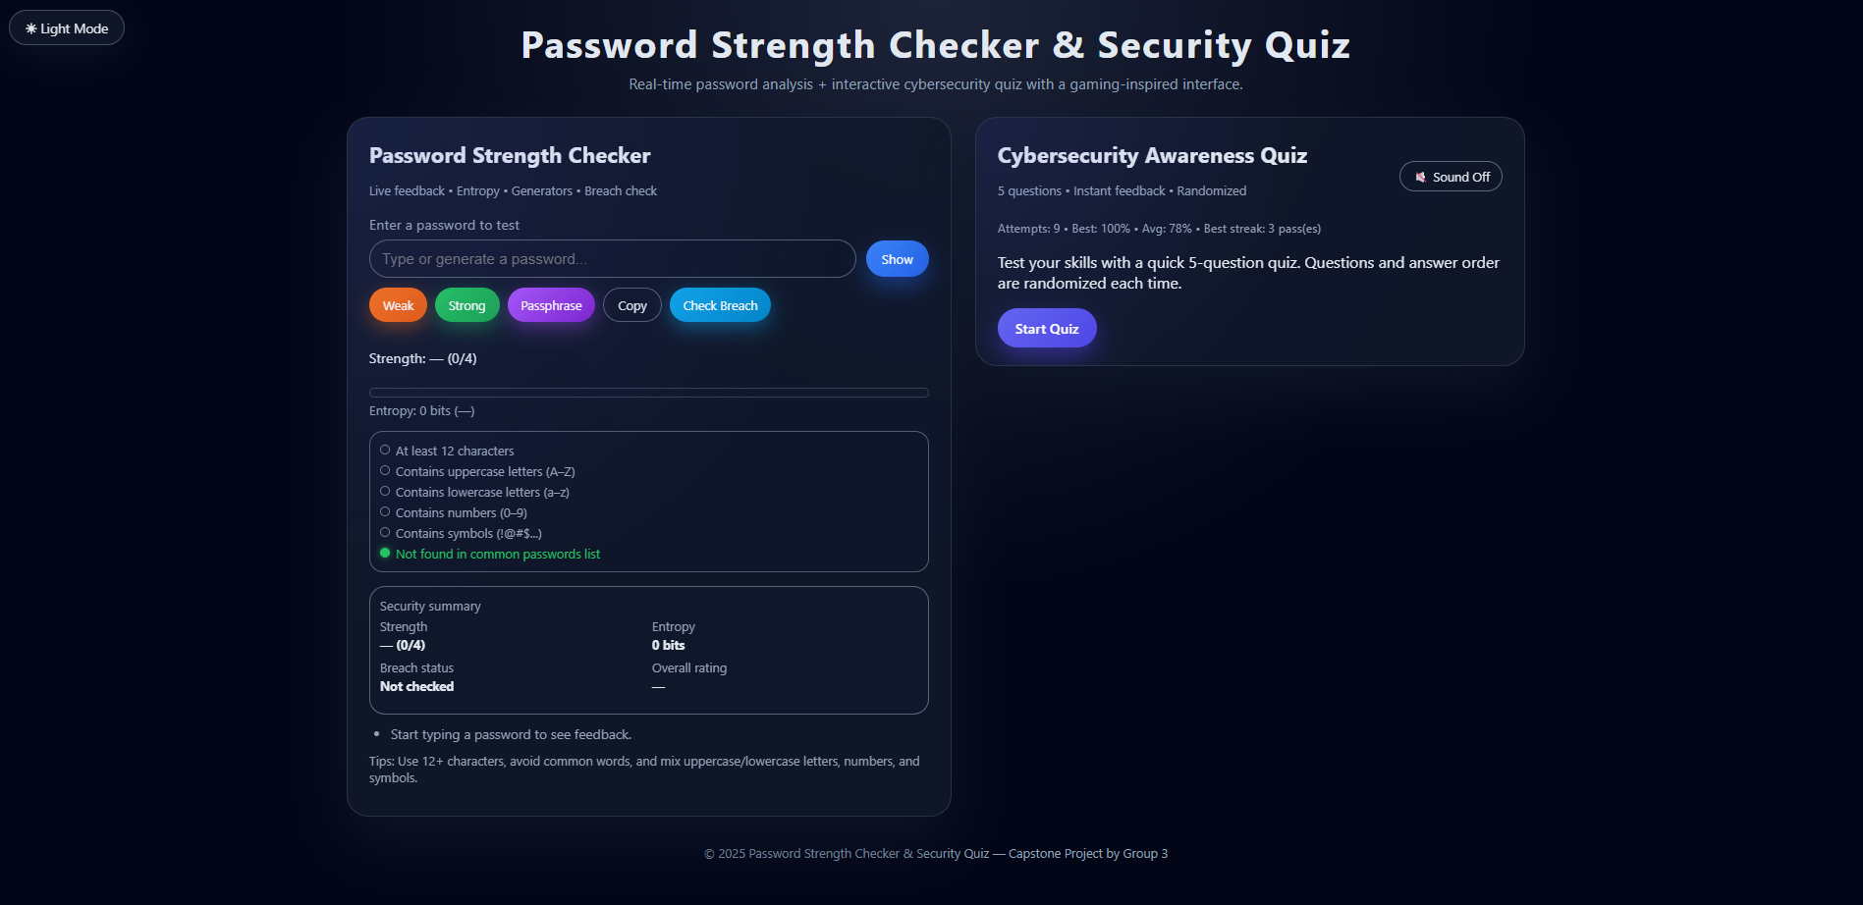
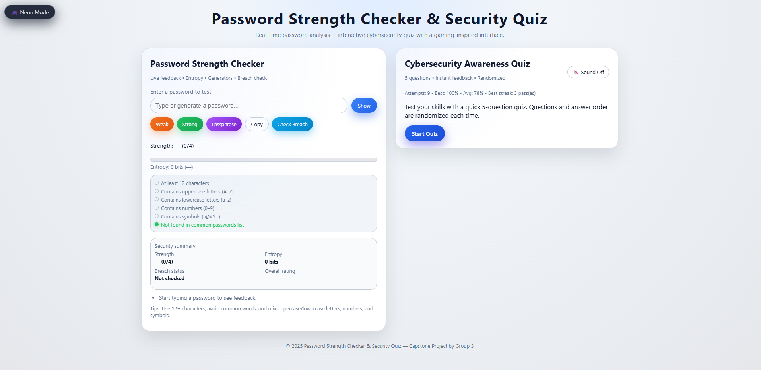
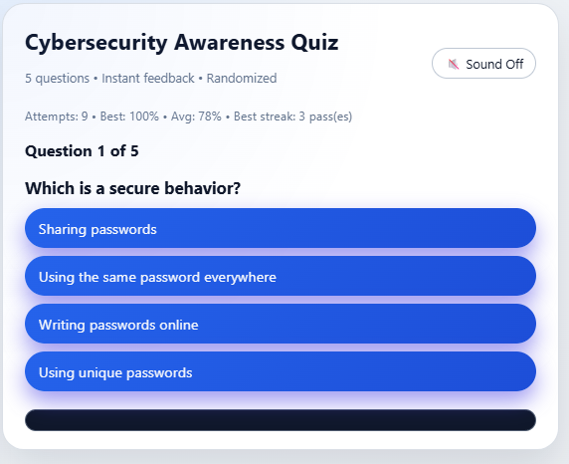
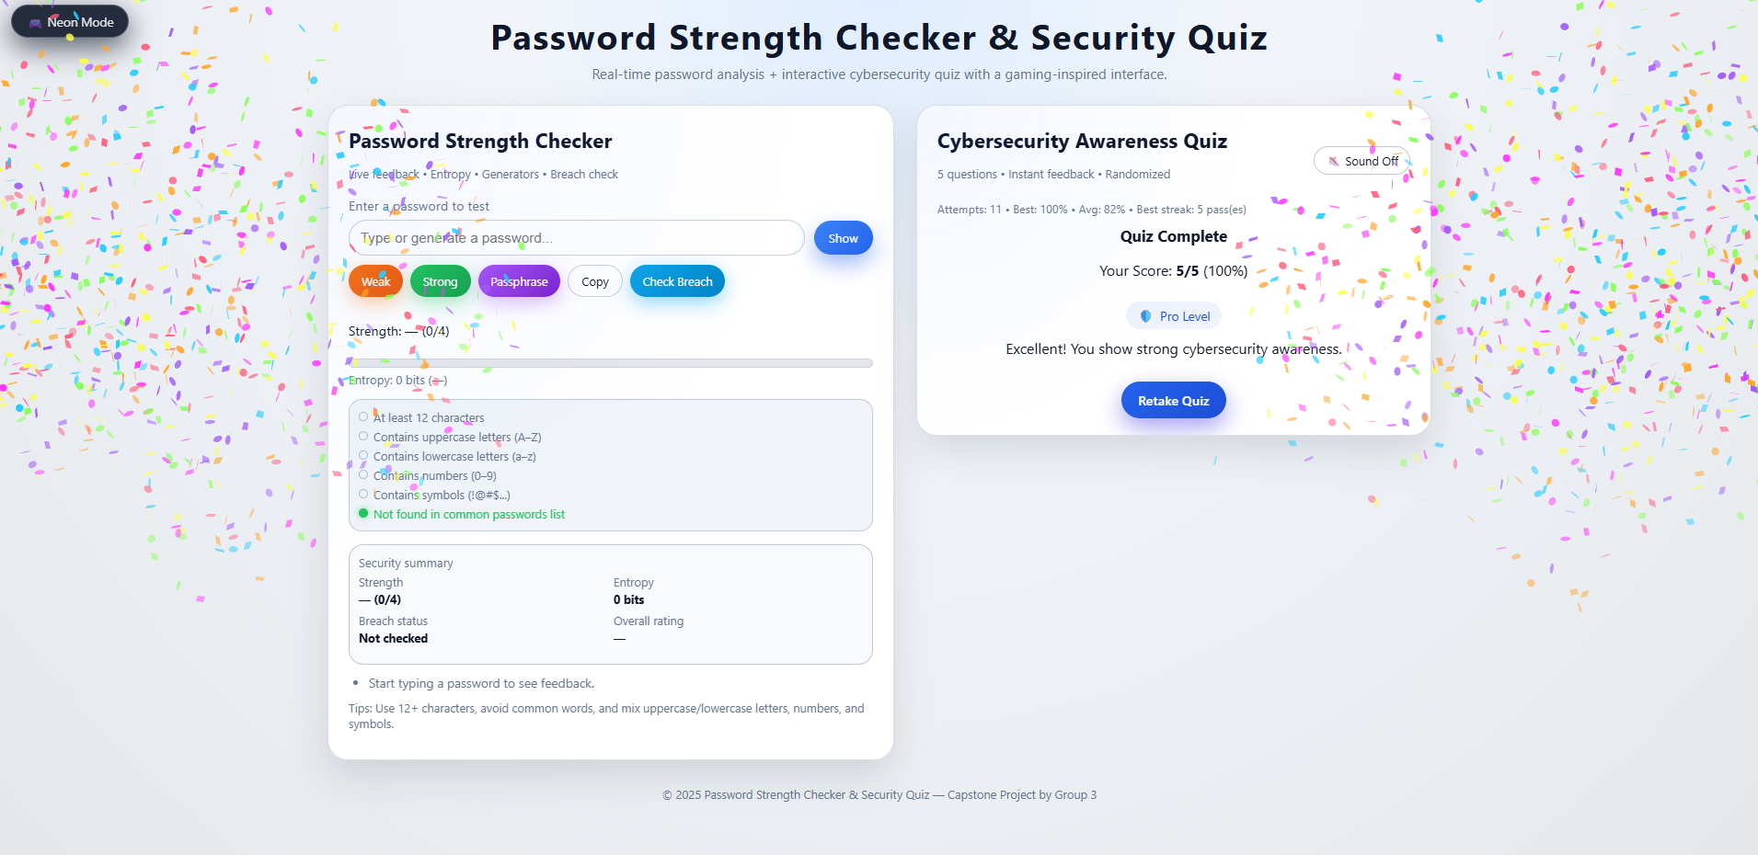
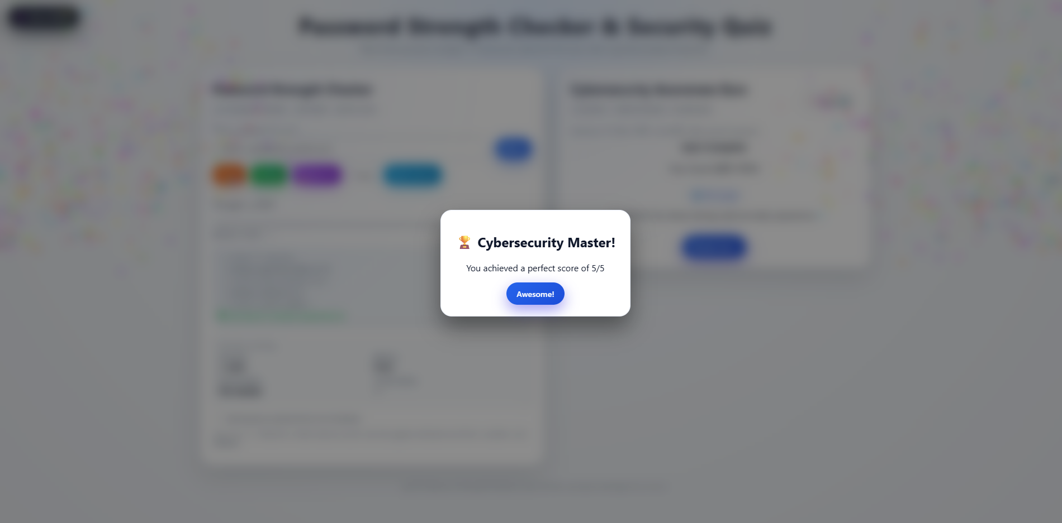

Slide 15
Thankyou!

